Slide 1
Basic C#

Slide 2
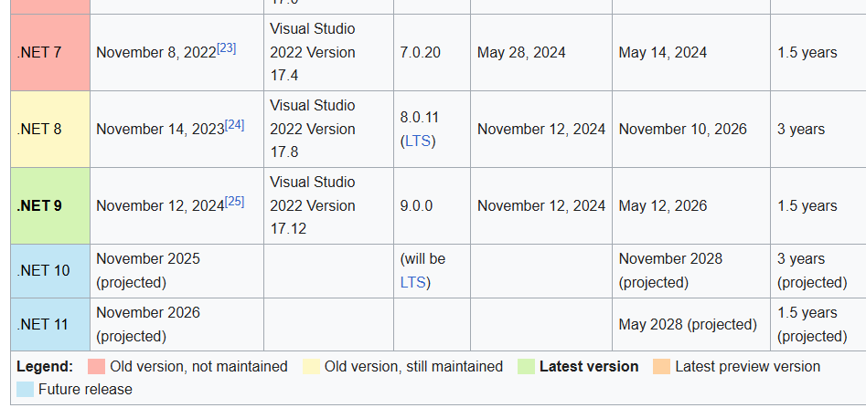
.Net
Software framework by Microsoft
From Wikipedia, last update: September 2025

Slide 3
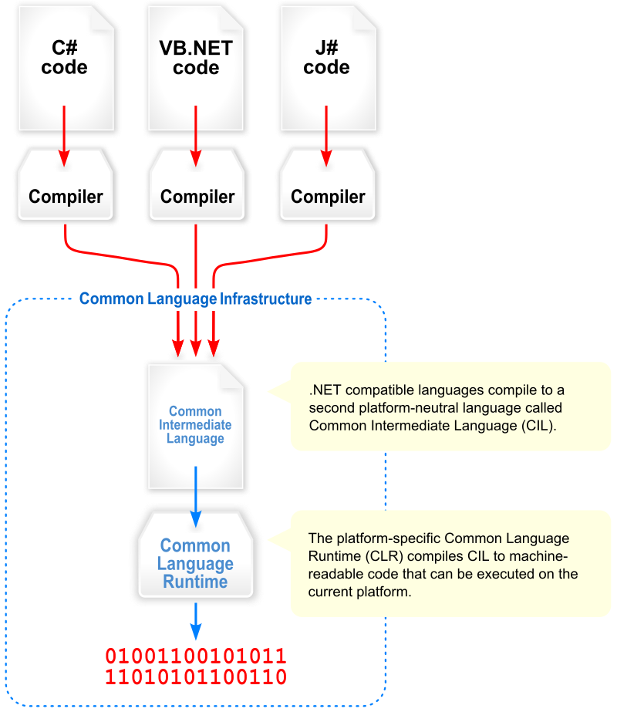
Mechanism

Slide 4
Quick start
onlinegdb.com
Console app

Slide 5
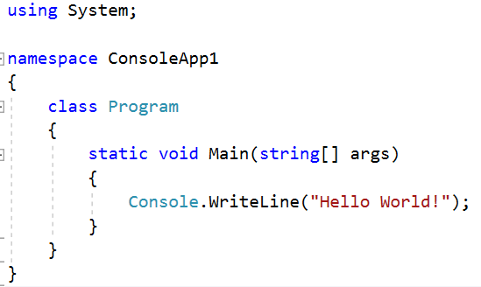

Hello world & artifacts
Create a new console app

Slide 6
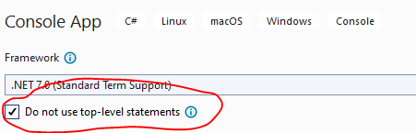
Top level statements

Slide 7
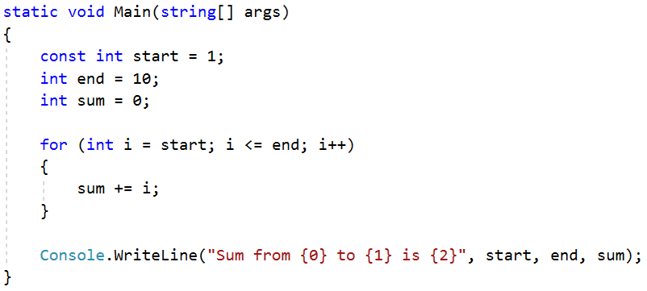

Constants & Variables
Write a program that calculate sum from 1 to 10

Slide 8
Messing around
Position of parameter for string format
String interpolation
$”Tong tu {start} den {end} la: {sum}”
Function examples
ref (chiếu) / out (yên tâm ra khỏi hàm sẽ có giá trị)

Slide 9
Artifact
Build (Ctrl + Shift + B) => Error
Run (F5) vs Run without debugging (Ctrl + F5)
Release vs Debug
Breakpoint & watch
Step in (F11) & Step over (F10) & step out (Shift + F10)
Set as startup project
Open project location

Slide 10
Exercises
MinInteger: Cho biết số nhỏ nhất trong 3 số nguyên a, b, c với giá trị code cứng cho trước.
Triangle: Tính chu vi và diện tích tam giác từ độ dài 3 cạnh a, b, c với giá trị code cứng cho trước
1. Algorithm design using Pseudo Code / Flow Chart
2. Implement
3. Unit test
4. Refactoring
5. Adding comments
6. Generate documents based on comments

Slide 11
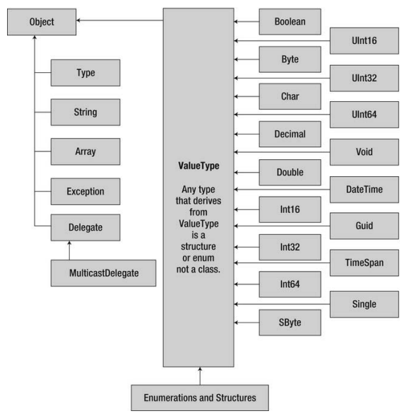
Types

Slide 12
Exercise
Write a function to check if
An integer is a prime number
An integer has all odd digits
bool IsPrime(int value) / CheckPrime
bool HasAllOddDigits(int value) / CheckAllOddDigits

Slide 13
Answer
Functin name must be a verb (to be is acceptable)
bool IsPrime(int number)
bool CheckAllOddDigits(int number)
bool HasAllOddDigits(int number)

Slide 14
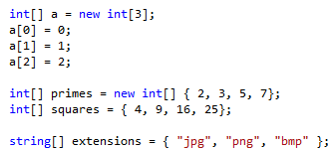
Array

Slide 15
Exercises
Given a date stored in 3 variables: day, month, year
(hard code, change everytime the app runs)
Write a function to check if these variables create a valid date
Write a helper function to check for leap year
Write a function that prints out the previous day
Write a function that prints out the next day
Create unit test

Slide 16
Advanced
Make all these above functions part of class DateTime

Slide 17
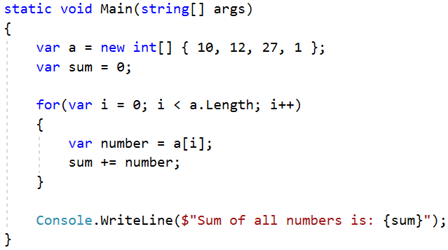


Loop through an array

Slide 18
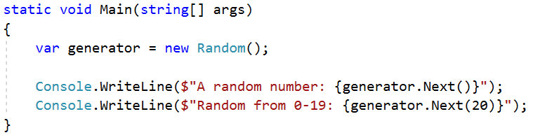
Random generator

Slide 19
Exercise
Generate 10 integers into an int array
Check if all integers are even numbers
Count the number of prime numbers
Create a sub array that contains all odd numbers

Slide 20
Number casting
// Small to big -> OK
byte b = 5; // implicit int to byte
int i = b; // i = 5
// Big to small -> NOT OK
int i = 500;
byte j = i; // compile error
byte j = (byte)i; // i = 244

Slide 21
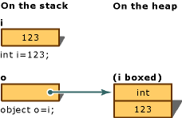
Boxing / Unboxing
Boxing: convert value type to object
Unboxing: extract value type from object

Slide 22
Exercise
Understanding the boxing/unboxing mechanism
int i = 7;
string name = i.ToString() + “ $”; // Integer
int result = i.CompareTo(100);
Java: (new Integer(i)).toString())

Slide 23
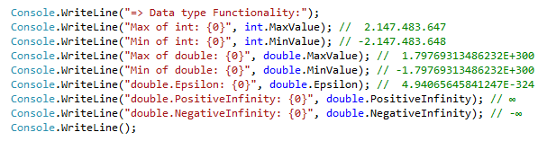
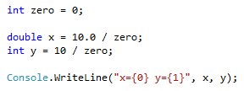
Minimum & maximum value
Result?
Notes:
Số nguyên chia cho 0 thì văng exception
Số thực chia cho 0 thì ra infinity :v

Slide 24
Operation 1/2
References: . () [] new ->
Arithmetic: + ++ - -- * / % sizeof
Logical: & | ^ !
Conditional: && (&) || ! == != > >= < <=
Type verification: is as typeof
Bitwise: ~ >> <<
Assignment: = += -= *= /= %= &= |= ^= >>= <<=
Selection: ?: ?? (not null)
Lambda expression definition: =>

Slide 25
Operation 2/2
int i = 5;
// Selection ?:
string x = i == 5 ? "Yes": "No";
int? x = 5; // nullable type
int y = x ?? 0; // Selection ?? operator
int z = x; // Error: nullable type
// cannot assign to non-nullable type
// Lambda expression – anonymous method
(int x) => x * 2;
⇔ public int PowerUp(int x){return x * 2;}

Slide 26

Use String format for concatenation
Positive: right align, negative: left align

Slide 27


String concatenation
Use “+” character
Use StringBuilder
Use string interpolation with $“{variable}”
Use string.Format

Slide 28
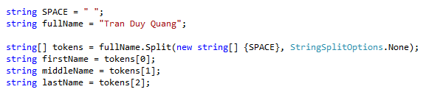
String Split
StringSplitOptions.RemoveEmptyEntries
Exercise
Calculate sum of string numbers = “5,3,8,11,-12,3”
Comma separated values : .csv file
Split String fraction = “3/4” into int numerator and denominator
What if we meet 3//4?

Slide 29
Currency format
CultureInfo culture = CultureInfo.GetCultureInfo("vi-VN"); // en-US /en-UK
int money = 1250000;
1. string formatted = money.ToString("#,### đ", culture.NumberFormat);
2. string formatted = string.Format(culture , "{0:c}", money);
$n, n$, $ n, n $ => 0 1 2 3
1.000.000,29 đ 10/07/2023
$ 1,000,000.29 07/10/2023
Cùng 1 dữ liệu => nhiều cách hiển thị khác nhau
6/8 => 3/4 => 75% => 0.75

Slide 30
Currency format using Regular expression
string info = Regex.Replace("1234567",
@"\d{1,3}(?=(\d{3})+(?!\d))",
"$&."); // 1.234.567
\d{1,3}: 1-3 digits
?=(\d{3})+: lookahead, after 1-3 digits, must follow by 3 digits, repeats more than one
?!\d: negative lookahead, must follows by no digits

Slide 31
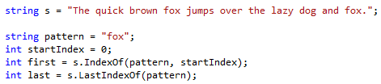
String search
Exercise
Given string s = “She sells seashells by the seashore. The shells she sells are seashells”
Calculate the number of occurrence of the word “sells” and “she”
Further reading: replace and regular expression

Slide 32
String Exercises
1. Read a string and give statistics about the number of occurrence for each of the word in the string.
2. Normalize a string of full name and print out on the screen: no more than one spaces between words, the first letter is capitalized meanwhile the rest are in lower case, no space in the beginning and the end of the string.
3. Split string fullpath = “C:\Documents\Photos\Test.jpg” into:
a) Containing directory b) File name c) Extension

Slide 33
Path extraction
FileInfo vs Path
Path.GetDirectoryName
Path.GetFileName
Path.GetFileNameWithoutExtension
Path.GetExtension

Slide 34
DateTime
using System;
DateTime a = new DateTime();
// Full construction
DateTime b = new DateTime(2025, 01, 15, 20, 06, 31, 927);
// Current time
DateTime today = DateTime.Now;

Slide 35
Datetime string display
var culture = CultureInfo.GetCultureInfo("vi-VN");
var now = DateTime.Now;
now.ToString(culture); // 15/01/2025 22:07:25
now.ToLongDateString(); // Monday, July 10, 2023
now.ToShortDateString(); // Mon 10 07 2023
How about 10-07-2023?
now.ToString("dd-MM-yyyy", CultureInfo.InvariantCulture)
now.ToString("dd/MM/yy", CultureInfo.InvariantCulture)

Slide 36
Telephone number
Learn regular expression
Regexr.com
With example: https://learn.microsoft.com/en-us/dotnet/standard/base-types/regular-expression-language-quick-reference
phone = Regex.Replace(phone,
@"(\d{4,5})(\d{3})(\d{3})",
"$1-$2-$3"
);
“0986111222”
=> “0986-111-222”
=> “0986.111.222”

Slide 37
Flow control
Branching
Selection: ?: ??
if… else if … else
switch … case … default
Iteration
for
foreach
do while
while
Ignore & breaking
continue
break

Slide 38
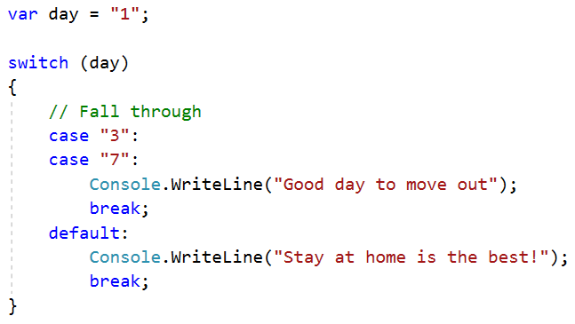
switch case example

Slide 39
Tuple
Creating a tuple
var result = new Tuple<int, string>(200, “OK”);
Accessing elements in a tuple
int code = result.Item1;
string message = result.Item2;
Destructuring a tuple into multiple elements
var (code, message) = new Tuple<int, string>(
404, “File not found”);

Slide 40
Dictionary
Key-Value store
var enDict = new Dictionary<string, string> {
{“one”, “một”},
{“two”, “hai”},
{“three”, “ba”}
};

Slide 41
Dynamic Array
List<int>
List<string>
IEnumerable<int>
IEnumerable<string>
ArrayList

Slide 42
Basic coding convention

Slide 43
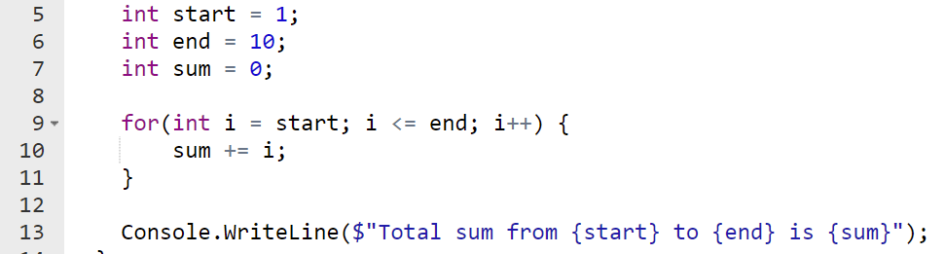
if for do while
Add an empty line before and after
Always use brackets even if there is one line of code

Slide 44
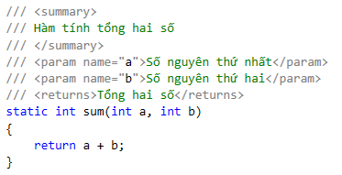
Comment
Should provide purpose of a block of function
XML comment for document generation (doxygen)

Slide 45
Function name
Start with a verb
Private: _camelCase
Public: PascalCase
Good: isPrime, checkExists, called, calling
didCall, willChange
Avoid: doCalculate => calculate
Quiz: Check if a element exists in an array

Slide 46
Constants
PascalCase

Slide 47
Exercises
Check if a number is a prime number
bool IsPrime(int number) / LaSoNguyenTo()
Check if a number is a square number
bool isSquare(int number) / LaSoChinhPhuong()
Calculate x^{n}
double Pow(double x, int n) / LuyThua

Slide 48
Text File
File.ReadAllLines(string filename)

Slide 49
Json
string content = File.ReadAllText(input);
List<Student> students =
JsonSerializer.Deserialize<List<Student>>(
content
)!;

